Slide 1
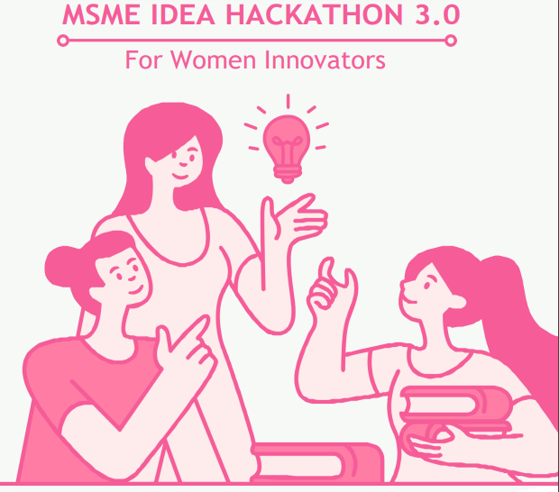

Slide 2
Assurance
I assure that the Ideas which is not already exist
I assure that the Ideas is not infringement/theft
I assure that the Ideas which are not against established scientific theories/norms
SIGNATURE
Anisa F

Slide 3
1. Details of Women Innovators/Incubate

Slide 4
1.1 Details of the Host Institute (HI) : K.S.RANGASAMY COLLEGE OF TECHNOLOGY , KSR Kalvi Nagar, Tiruchengode, Namakkal District, Tamil Nadu, India – 637215
1.2 Name of the Business Incubator (BI): Dr.N.TIRUVENKADAM
1.3 Category of the Incubatee: Student
1.4 Aadhar No.: 218598633472
1.4.1 Name in Aadhar: Anisa F
14.2 Incubate Name: K.S.RANGASAMY COLLEGE OF TECHNOLOGY
1.5 State: TAMIL NADU
1.6 District: Namakkal
1.7 Email Id: anisafairoz@gmail.com
1.8 Mobile Number: 9942651212
1.9 Category: OBC
1.10 Gender: Female
1.11 Address: 18-B Pykara Street, Shevapet, Salem - 2

Slide 5
2. Details of Idea

Slide 6
2.1 Title of proposed idea/innovation:
" Treasure Traders : Journey through India "
2.2 Whether the idea involves the use of existing intellectual property or not, give brief detail there of:
No, the innovation lies in the integration of immersive cultural experiences, realistic trading mechanics, interactive learning, and cross-cultural exchange, all packaged into an engaging board game.

Slide 7
2.3 Briefly explain the newness/uniqueness of the innovation:
Immersive cultural experience: Integrating the diverse culture, traditions, and climates of Indian cities.
Realistic trading mechanics: Simulating real-world market dynamics and economic principles.
Interactive learning: Engaging and enjoyable gameplay that promotes critical thinking and knowledge retention.
Customizable gameplay: Adaptable difficulty levels and rule variations for different preferences and skill levels.
Cross-cultural exchange: Promoting communication, negotiation skills, and appreciation for different perspectives.
2.4 Concept & Objective:
"Treasure Traders: Journey through India" is a board game that combines entertainment and education, allowing players to embark on a journey across India to explore famous cities, learn about their unique goods, and engage in strategic trading activities.
The objective of the game is for players to accumulate the most wealth by making shrewd trading decisions, leveraging market conditions, and capitalizing on the diversity of goods found in Indian cities.
Through gameplay, players will enhance their knowledge of Indian culture, geography, and trading practices while honing their strategic thinking and decision-making skills.

Slide 8
2.5 Specify the potential areas of application in the industry/market in brief:
Educational Institutions: Marketing the game to schools, colleges, and educational institutions as a tool to teach students about Indian culture, geography, economics, and trading principles.
Tourism and Travel Industry: Collaborating with travel agencies, tourist attractions, or hotels to promote the game as a cultural and educational experience for tourists visiting India.
Gift Shops, Souvenir Shops and Online Retail Platforms: Partnering with gift and souvenir shops to feature the game as a unique and educational souvenir related to Indian culture and trading heritage. Leveraging e-commerce platforms to reach a wider audience, offering the game as an educational and entertaining product with nationwide or global shipping capabilities.
2.6 Briefly provide the market data for the potential idea/ innovation:
Growing board game industry offers opportunities.
Emphasis on culture fits educational trends.
Capitalizes on Indian tourism surge.
Appeals globally, fostering cross-cultural exchange.
Collaborations expand reach through partnerships.

Slide 9
Business Model
Revenue Streams:
Sale of Board Expansion Pack Games or DLCs Merchandise and Accessories.
Key Activities:
Game Development Production and Manufacturing Marketing and Promotion
Key Resources:
Game Designers and Artists Manufacturing Partners Distribution Channels
Customer Segments:
Board Game Enthusiasts Cultural Enthusiasts Gift Shoppers
Customer Relationships:
Engaging Community Customer Support
Channels:
Online Sales Retail Partnerships Conventions and Events
Cost Structure:
Game Development Costs Manufacturing Costs Marketing and Promotion Expenses Operational Costs

Slide 10
2.7 Name and details of Mentors:
Dr.J.Nithya
Professor
2.8 Experience and Qualification of Mentors:
24 years of teaching experience
B.E.,M.E.,PhD

Slide 11
2.9 Contact Details of Mentors:
Mail id: nithyaj@ksrct.ac.in
Phone No.: 9443846125
2.10 Current Development Status of Innovation:
The current development status of the " Treasure Traders: Journey through India " innovation is in the conceptual stage. The idea has been formulated with a clear vision, innovative features, and potential market applications. However, the detailed design, prototyping, playtesting, production, and distribution processes have not been initiated as of the present.

Slide 12
2.11 Expected time of completion of idea:
Estimated completion time: 12-18 months, considering design, testing, production, and marketing stages.
2.12 Idea Sector:
Sector: Service Sector (Education),
Theme: AVGC (Animation, Visual, Gaming, Comics)

Slide 13
3. Financial requirements

Slide 14
Maximum ₹15 lakhs- incubation support under the Ministry’s MSME Innovative Scheme
3.1 Activity-wise break
Particular/Item | Total idea project cost (Rs. In lakh) | Amount GOI assistance (Rs. In lakh) | Incubatee share (Rs. In lakh)
Technology related Expenditure towards machine usage charges etc., Electricity charges, Procurement of raw material , testing/Calibration charges, other charges essential for development of idea Max (10.00) lakh. | 4,50,000 | 4,50,000
Charges for mentor/handholding supporting team Max (3.00) lakh. | 2,00,000 | 2,00,000
Travelling Expenses or any other item not coverd as above may be allowed as per need for development of the idea Max ( 2.00) lakh. | 1,20,000 | 1,20,000
Total | 7,70,000 | 7,70,000

Slide 15
4. Other students/Entrepreneurs associated with this project/idea

Slide 16
4. Other students/Entrepreneurs associated with this project/idea
Name of the Students | Aadhar No./Udhyog Aadhar No./Udyam Registration
Mehasri M A | 473883646807

Slide 17
5. Summary of the idea. (Technical solution)
“Treasure Traders: Journey through India " is a culturally immersive educational board game that uses strategic gameplay to teach players about Indian cities, goods, and trading practices. The game employs randomized mechanics, unique city cards, and economic principles to create engaging, authentic trading scenarios. It targets a diverse audience and can be marketed to educational institutions, tourism, retail, and online platforms. The game's technical solution includes interactive gameplay mechanics, accurate cultural representation, and the potential for expansion packs and digital versions.
6 (a) Is it a new concept?
Yes, the board game combines cultural immersion, realistic trading mechanics, interactive learning, and customizable gameplay in an engaging and educational experience
(b) Prior art on the concept, if any
No

Slide 18
7. Main Problem Being Addressed in the Project (Highlight the specific problem & solution addresses)
Cultural Immersion: Integrates the diverse culture, traditions, and climates of Indian cities to offer players an authentic cultural experience.
Realistic Trading Mechanics: Simulates real-world market dynamics and economic principles, enabling players to make strategic decisions and understand trading practices.
Interactive Learning: Promotes critical thinking and knowledge retention through enjoyable gameplay that teaches players about Indian culture, geography, and trading.
Customizable Gameplay: Adapts to different preferences and skill levels with variable difficulty levels and rule variations.
Cross-Cultural Exchange: Encourages communication, negotiation skills, and appreciation for different perspectives, fostering cultural understanding.
Replayability and Variety: Offers endless entertainment value with a large set of unique city cards and randomized gameplay.

Slide 19
8. Background for getting the idea?
Who is it for?
" Treasure Traders : Journey through India " is a board game suitable for diverse audiences, including individuals over 10, curious learners, families, and strategic thinkers interested in geography, culture, and economics.
b) What will it do?
The game offers an immersive experience across India's cities, allowing players to learn about unique goods, cultural aspects, and trading dynamics through strategic trading decisions.
c) Any unique features? Explain?
Cultural Immersion: The game authentically represents diverse Indian cities, their goods, and trading practices, offering players an engaging cultural experience.
Realistic Trading Mechanics: By simulating real-world market dynamics and economic principles, players gain insights into trading strategies and decision-making.
Interactive Learning: The game combines entertainment with education, enhancing critical thinking and knowledge retention while fostering curiosity about India. Cross-Cultural Exchange: Players practice negotiation skills, communication, and appreciation for different perspectives, promoting cultural understanding.
Educational Integration: The game can be used as a teaching tool in schools and colleges, aligning with educational curricula related to culture, geography, and economics.
Market Potential: The game's potential to reach educational institutions, tourists, online platforms, and cultural events positions it as a valuable product in various markets.

Slide 20
9. How simple or complex will the idea’s execution or implementation be?
Creating the " Treasure Traders : Journey through India " board game involves a moderate level of complexity. Balancing gameplay mechanics, creating authentic artwork, incorporating accurate educational content, playtesting, production, distribution, marketing, and potential expansions require careful planning and execution.
9.1 What are the risk factors involved in executing the idea?
Executing the “Treasure Traders : Journey through India " idea involves risks such as cultural sensitivity, accurate educational content, game balance, competition, manufacturing delays, market acceptance, legal issues, production quality, logistics, and changing trends. To manage these risks, thorough research, expert collaboration, playtesting, and adaptability are essential.

Slide 21
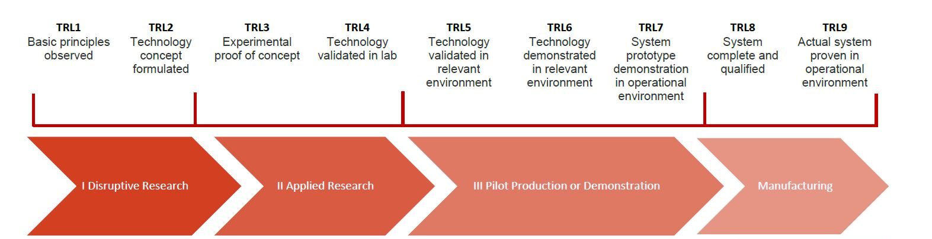
10. How soon could the idea be put into operation? (TRL of a prototype)
It has been conceptualized with a clear vision, but the execution process, including design, artwork, playtesting, production, and distribution, has not yet begun. Therefore, the Technology Readiness Level (TRL) of the prototype is TRL 2.

Slide 22
11. How much investment would you need for prototyping the Idea?
Investment Categoryx | Considerations | Investment Amount
Artwork and Illustrations | Hiring designers | 1,54,000
 | Hiring illustration artist | 1,15,500
 | Licensing fees | 77,000
Equipment | Raw materials | 1,15,500
 | Hiring printing press | 1,15,500
Quality Checking |  | 77,000
Game Testing |  | 1,15,500
Total | - | 7,70,000

Slide 23
12. (a) How do you intend to protect your idea (i.e. your intellectual property or IP)?
To safeguard the " Treasure Traders : Journey through India " board game idea, strategies like copyrighting artwork, design, and written content, trademarking the game's identifiers, and using NDAs with collaborators will be employed.
(b) Related Background. (Data related to or supporting your solution should not be in this section)
The game combines entertainment and education by allowing players to explore famous cities, learn about their unique goods, and engage in strategic trading activities by taking business games as a starting point. As a business game is a chance-based game, we’ve tried to implement this concept into a skill-based game.

Slide 24
13. How is this project made and used (how the innovation is implemented?)
The " Treasure Traders : Journey through India " project is implemented through these,
Conceptualization: Formulate the game idea, mechanics, and educational content.
Design: Create game components, artwork, and mechanics.
Prototyping: Develop a playable prototype for testing.
Playtesting: Refine mechanics based on player feedback.
Production: Source materials and manufacture components.
Marketing: Promote the game through various channels.
Distribution: Make the game available for purchase.
Engagement: Build a community and gather feedback.
Future Development: Consider expansions and adaptations.
How does the technical innovation actually work and what is the detailed process to achieve the technical innovation?
The technical innovation of " Treasure Traders : Journey through India " involves combining a card-based system with economic simulation and educational content. Randomized gameplay, decision trees, and player interaction create an immersive trading experience. The game mechanics, including scoring, feedback, and artwork, work together to seamlessly merge entertainment and education, offering an engaging and educational board game.

Slide 25
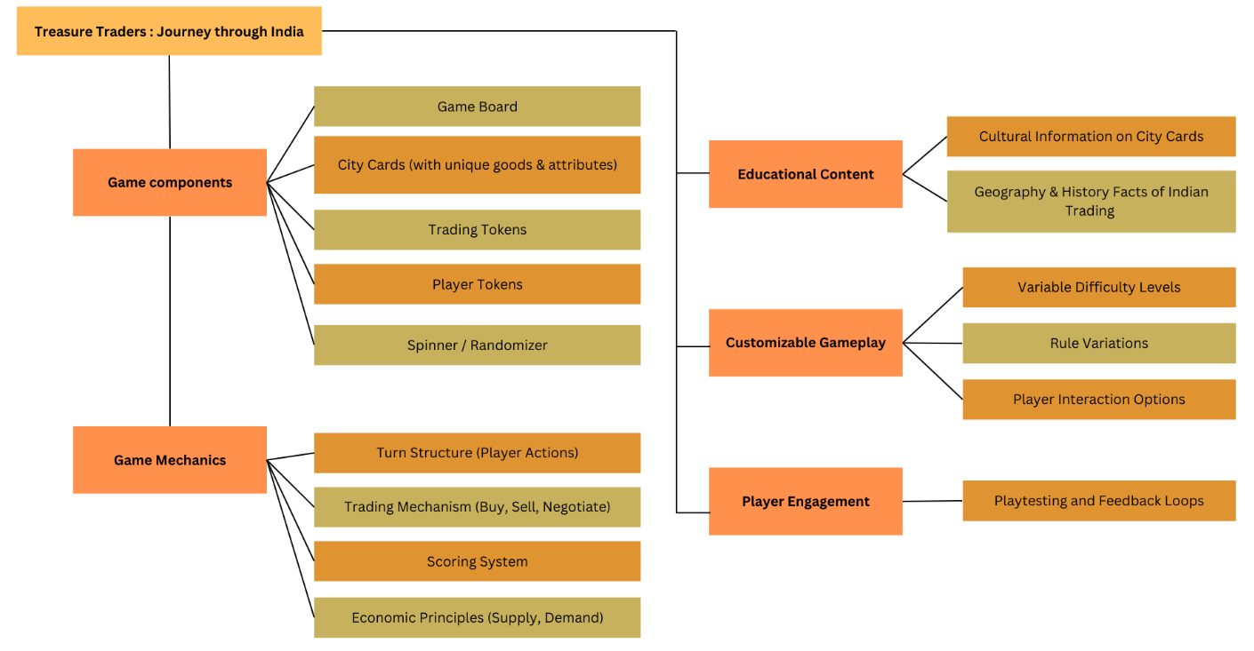
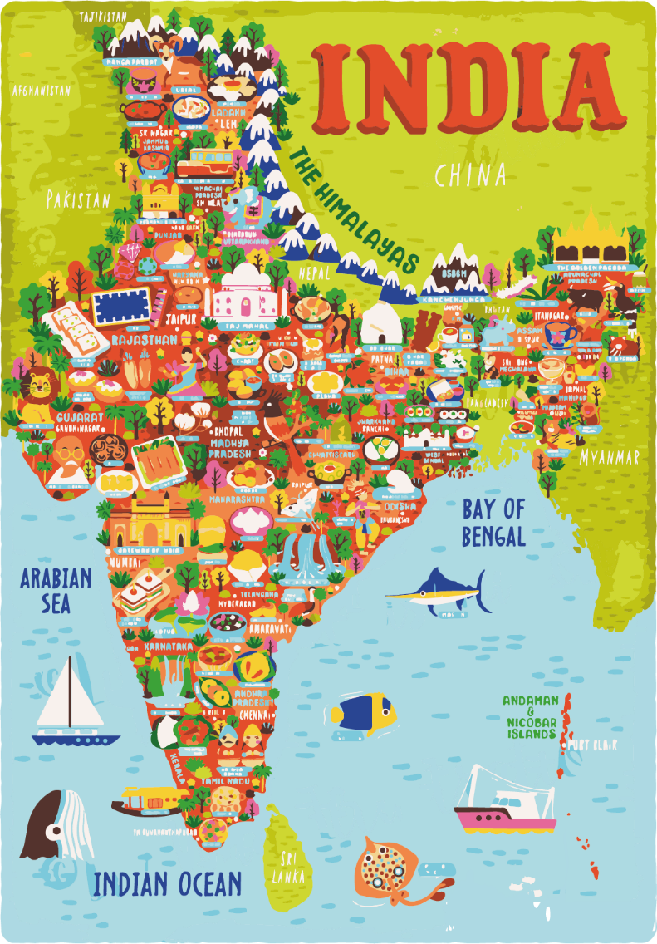
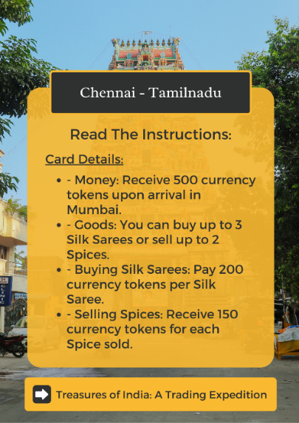
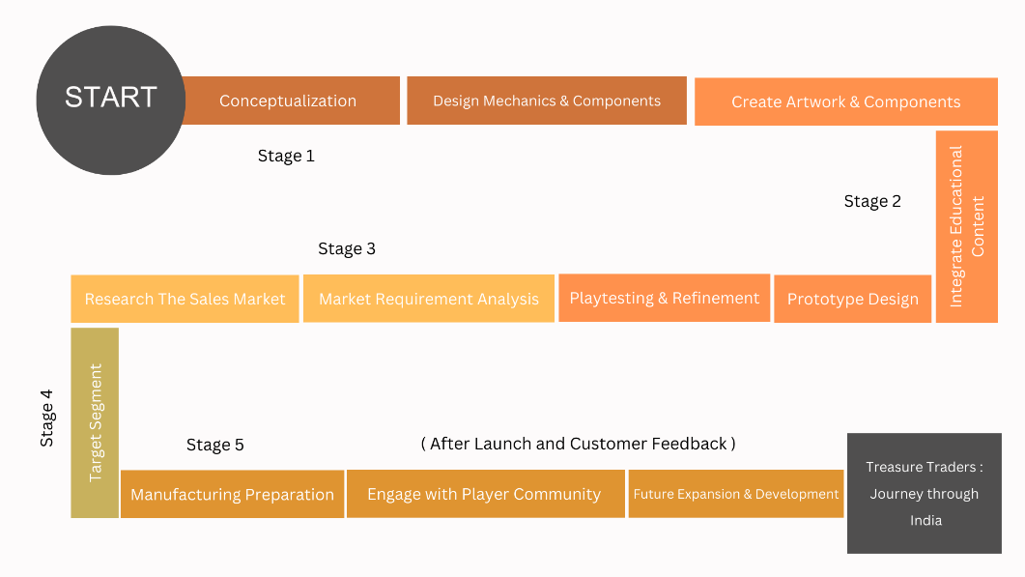
14. Upload a Block diagram/ flow chart/ Circuit Diagram/Pictures of a proposed idea.

Slide 26


